Slide 1
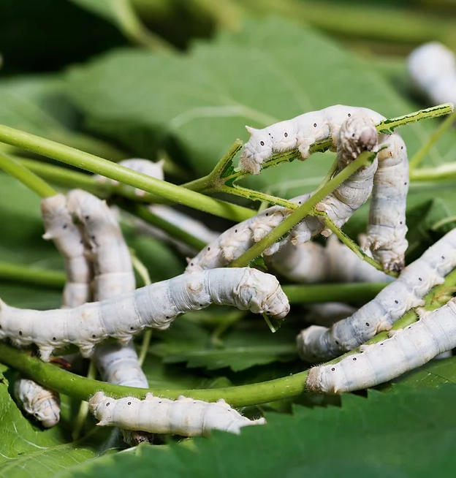
Silkworms

Slide 2
AGENDA
Nanchong Silk History and Praise
Life Cycle of a Silkworm
Processing Procedure of Silk
Our Business Motive
Let's Have a Look at Our Website

Slide 3
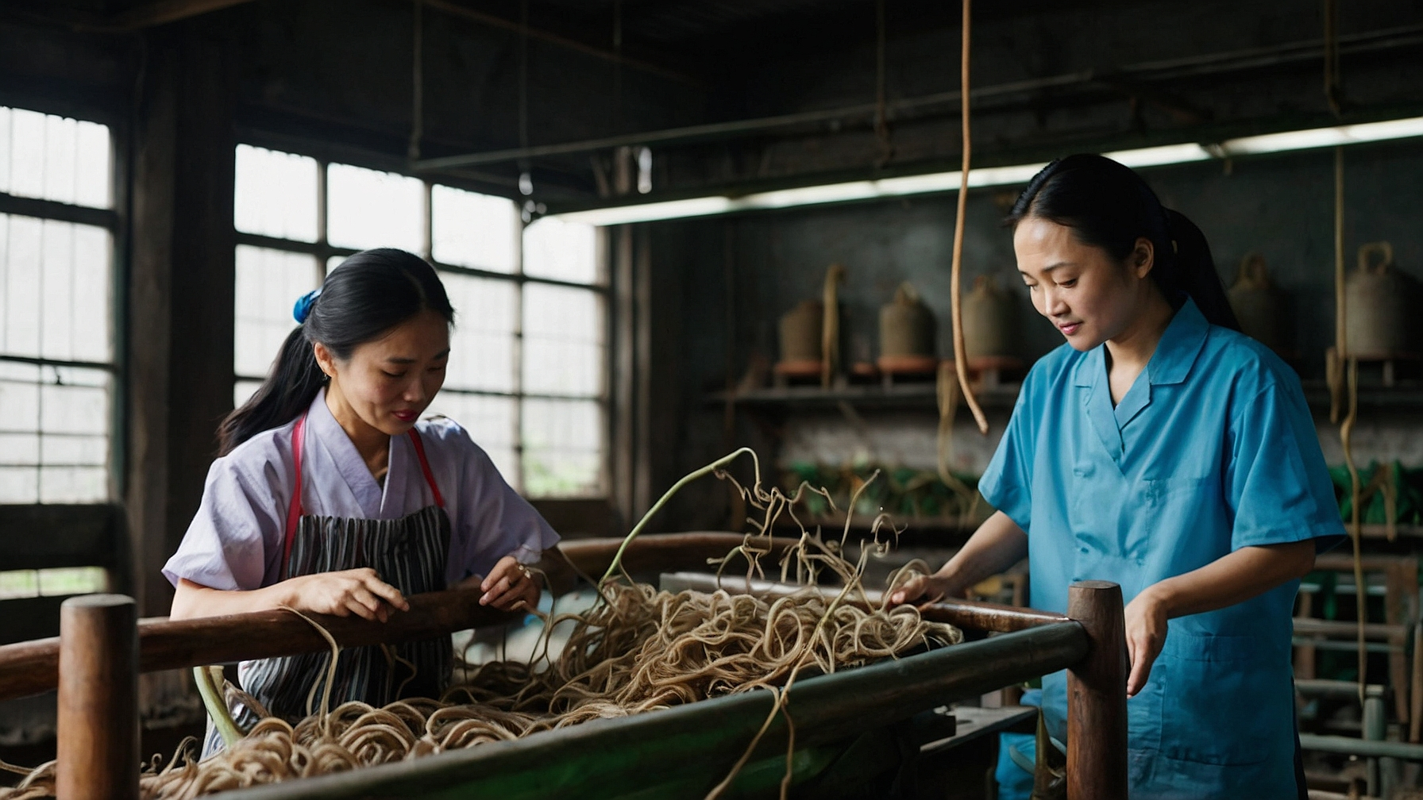
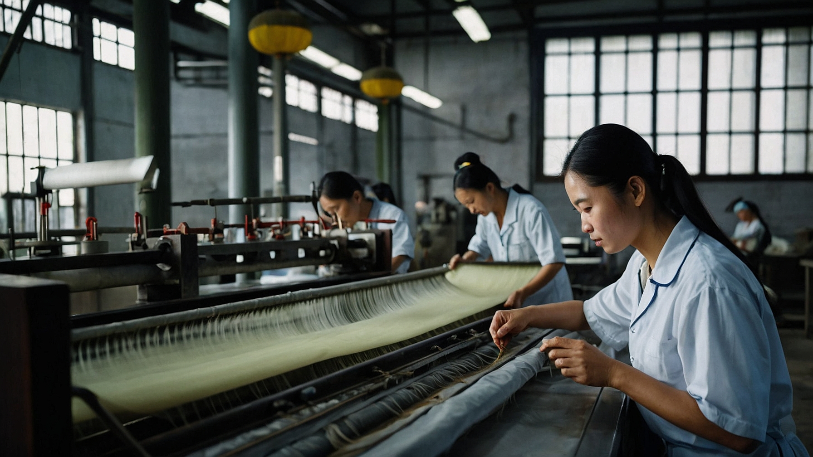

Slide 4
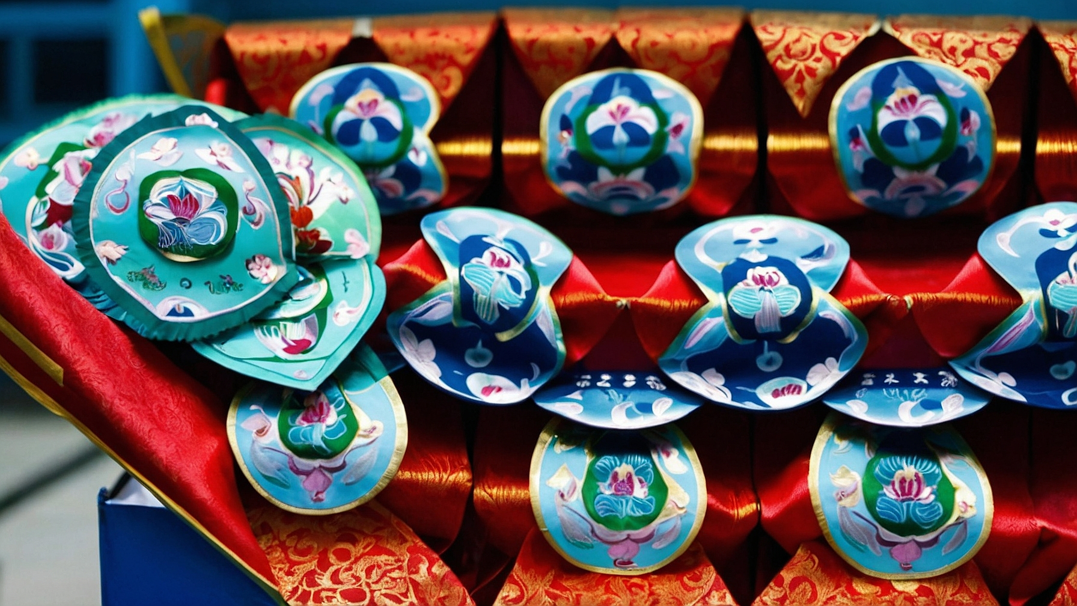
Nanchong Silk History and Praise
Nanchong is a city in the northeast of Sichuan province, China, and is famous for its silk industry.
Nanchong silk has a long history that dates back to the Han Dynasty (202 BC - 220 AD), when it was a major silk production center in the southwest of China.
Nanchong silk industry has a total output value of over 10 billion yuan and employs more than 300,000 people.
Nanchong silk products are exported to more than 30 countries and regions, including the US, Japan, Europe, and Southeast Asia.
Nanchong silk has won many awards and honors, such as the National Geographical Indication Product, the China Time-honored Brand, and the China Top Brand.

Slide 5
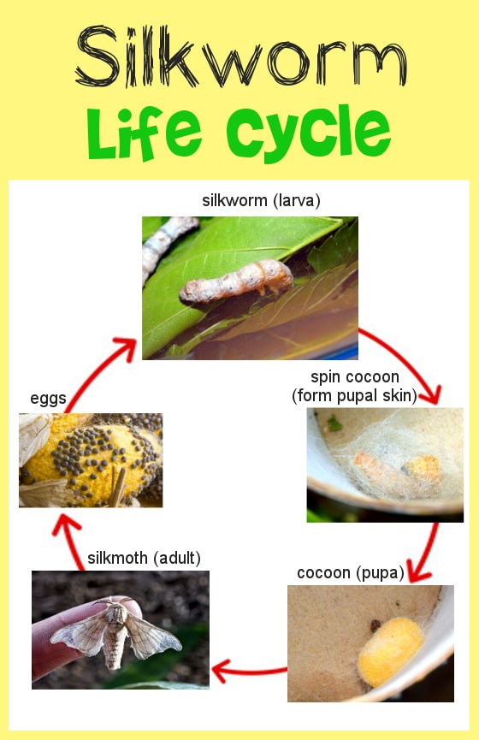
Life Cycle of a SilkWorm
Here are five short points on each stage of the life cycle of a silk
worm:-
Egg: The female silk moth lays hundreds of eggs, which are tiny, round, and yellowish. The eggs hatch into larvae after about two weeks.
Larva: The larvae are also called silkworms. They feed on mulberry leaves and grow rapidly. They have a segmented body and a pair of spinnerets on their head.
Cocoon: The silkworm spins a cocoon around itself by secreting a protein that hardens in the air. The cocoon is made of a single strand of silk that can be up to 1000 meters long.
Pupa: The pupa is the stage where the silkworm transforms into an adult moth. It is enclosed inside the cocoon and undergoes metamorphosis. The pupa stage lasts for about two weeks.
Moth: The moth is the final stage of the life cycle. It breaks out of the cocoon and mates. The female moth lays eggs and dies soon after, completing the cycle.

Slide 6
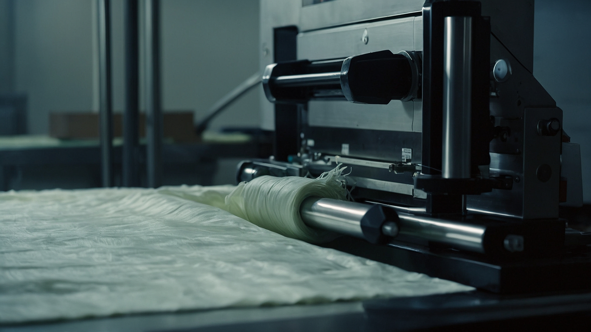
Processing Procedure of Silk

Slide 7
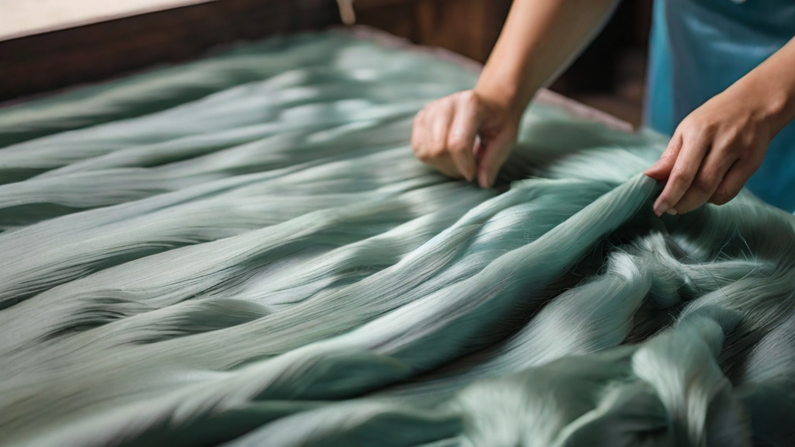
The processing of silk involves extracting the silk threads from the cocoons and turning them into silk fabric.
The cocoons are first sorted by size, color, and shape. Then they are boiled in water to soften and dissolve the gum that holds them together. This also kills the pupa inside the cocoon.
The silk threads are then reeled from the cocoons by using a special device that unwinds the fibers and forms them into skeins. The skeins are washed, dried, and graded according to their quality.
The silk threads are then spun, dyed, woven, and finished to create different types of silk fabric, such as satin, chiffon, brocade, and jacquard. The silk fabric is then cut, sewn, and decorated to make various silk products.

Slide 8
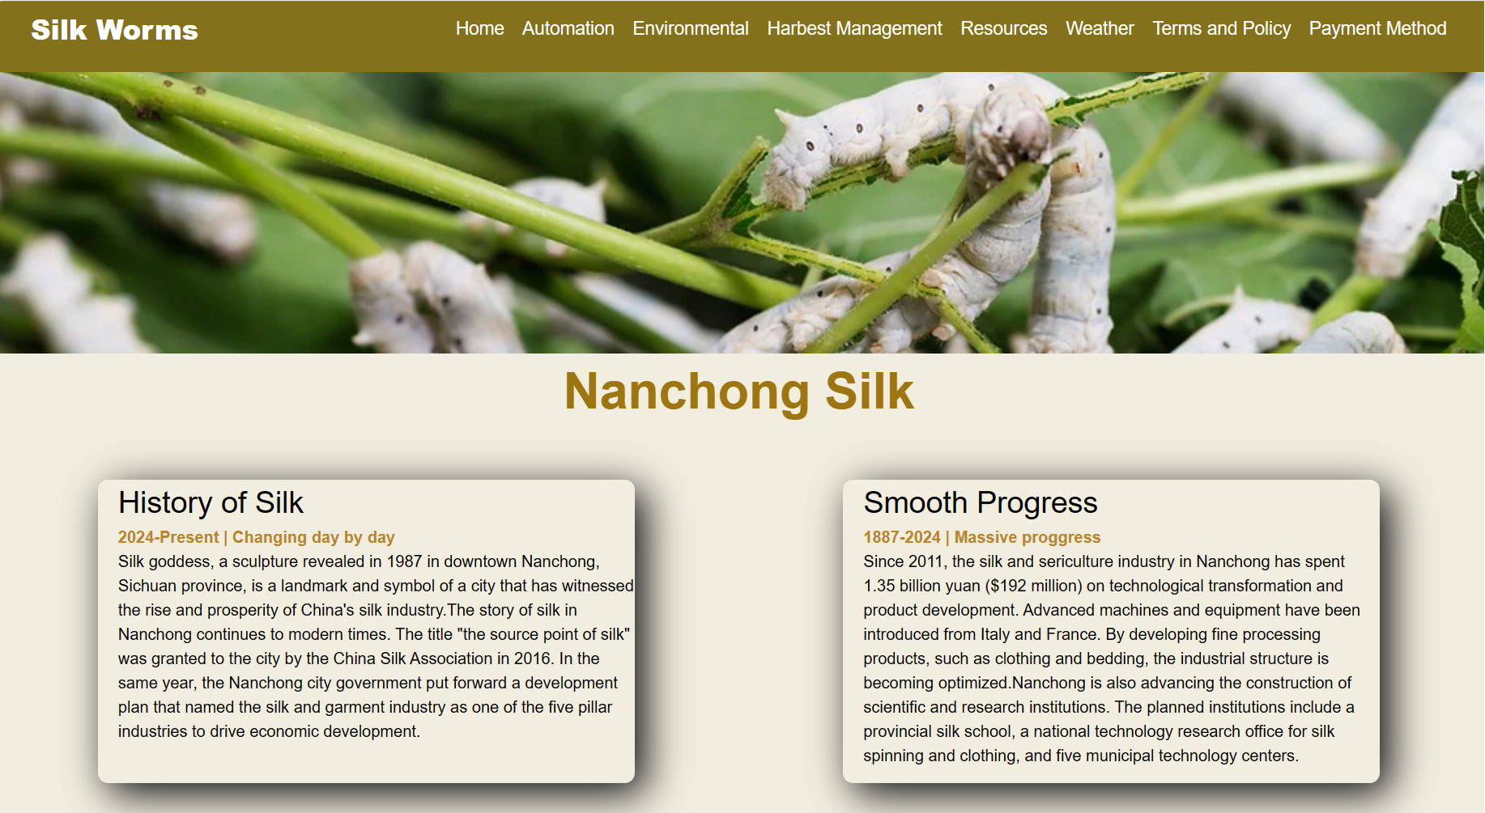
Our Business Motive
Our business motive is to spread Nanchong silk culture all over the world and express Chinese culture through our silk products.
We have a partnership with Nanchong Silk Thread Creator, a leading silk manufacturer in China that produces high-quality silk threads and fabrics.
We also make Chinese traditional silk cloth, such as cheongsams, tang suits, and silk scarves, that showcase the beauty and elegance of Chinese silk art.
We aim to promote Nanchong silk as a symbol of Chinese heritage, innovation, and fashion, and to share its value and charm with global customers.

Slide 9
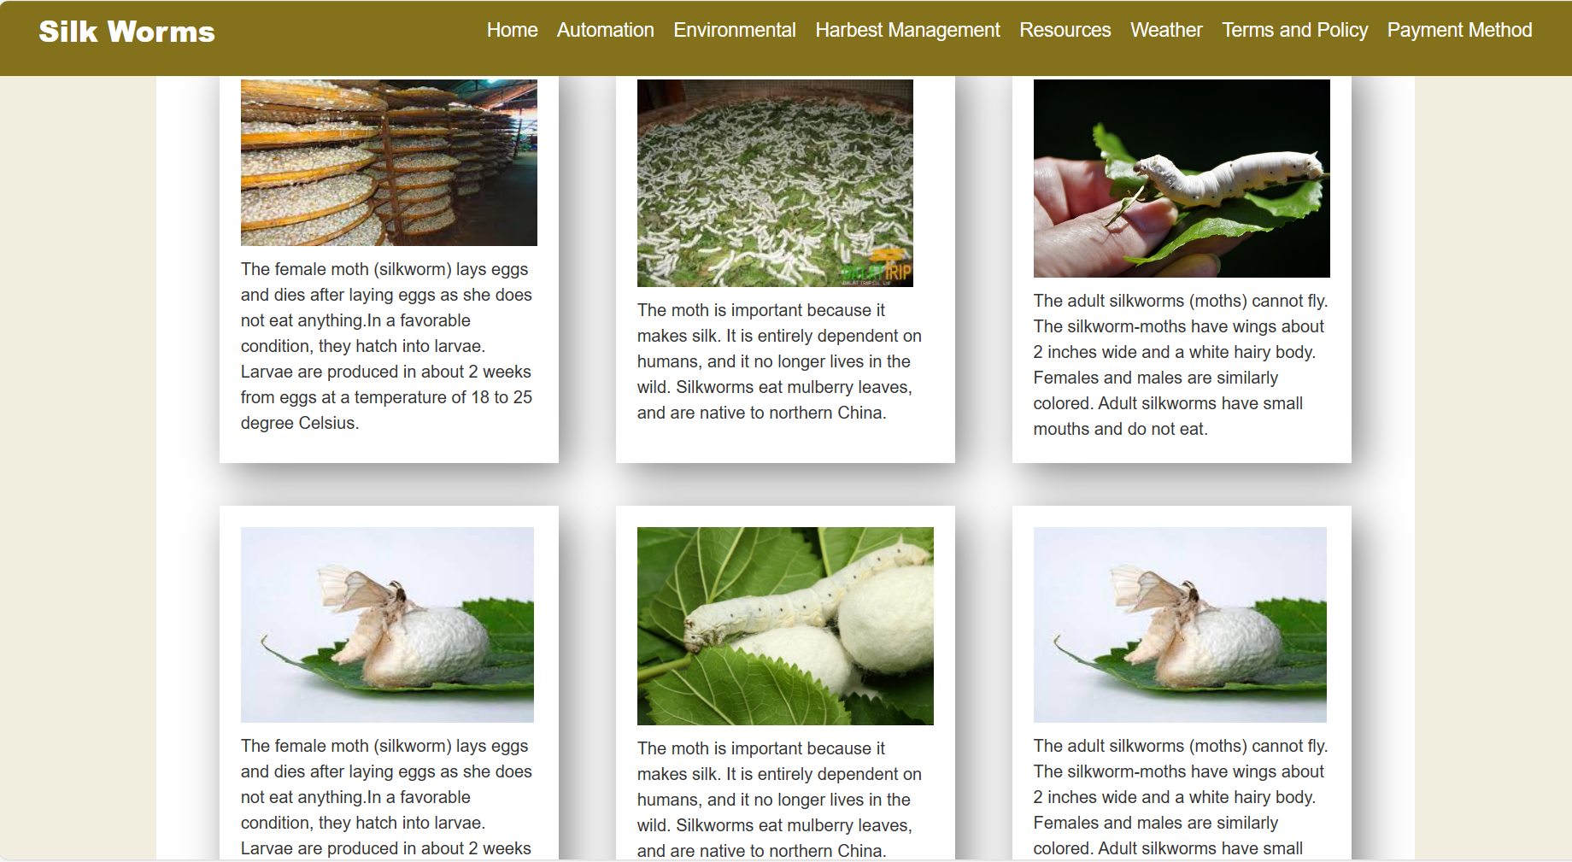
Let's Have a Look at Our Website
If you are interested in learning more about Nanchong silk and our products, please visit our website: SilkWorms
On our website, you can find more information about our history, vision, and mission, as well as our product catalog and contact details.
You can also order our products online and enjoy our fast and secure delivery service. We offer a variety of payment methods and a 30-day return policy.

Slide 10

Thank you for your attention and we hope you enjoy our presentation.
Please feel free to ask any questions or leave any feedback. We appreciate your support and cooperation.

